Slide 1
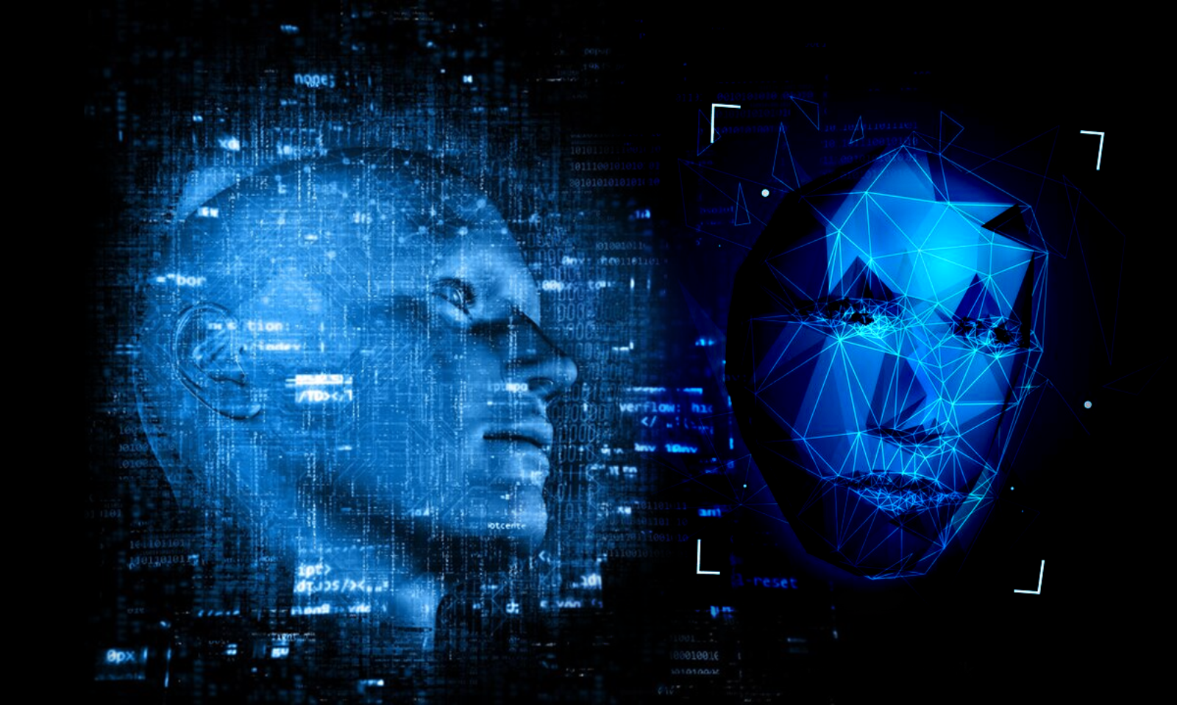
DEEPFAKE VIDEO CREATION
DIMITRIOS MITRAS , KONSTANTINOS BOUGIOUKAS

Slide 2
We will see…
What DeepFake and Face Swapping means?
Presentation of the process we followed and the models we used
Examples of the models
Output video with FaceSwapping a specific face

Slide 3
DEEPFAKE
DeepFakes refer to use of deep learning techniques to create realistic and often deceptive manipulations of audio, images or video content
Deepfakes are created using generative models such as GANs, which generate new content based on patterns learned from existing data
Face Swapping is the most common application of deepfakes, where a face of one person in convincingly replaced with the face of another.
It has gained popularity in various domains, primarily employed for entertainment and business purposes.
FACE SWAPPING
1

Slide 4

GENERAL IDEA
FACE DETECTION
FACE RECOGNITION
FACE SWAPPING
INPUT VIDEO
OUTPUT VIDEO​
FRAMES
MAIN STEPS
FRAMES
2

Slide 5
ΜΑΙΝ STEPS
FACE DETECTION (based on feature pyramid network FPN)
FACE RECOGNITION (based on deep CNN)
FACE SWAPPING
3

Slide 6
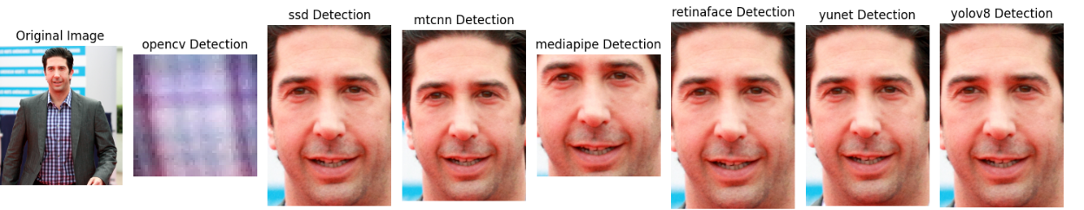
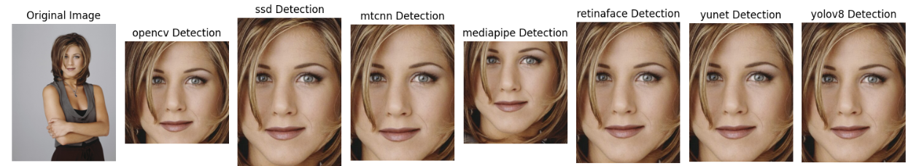
FACE DETECTION MODELS
4

Slide 7

FACE DETECTION MODELS
RETINA FACE: Use a Pre-triained model on more than 200K celebrity images, 5 landmark locations.
5

Slide 8
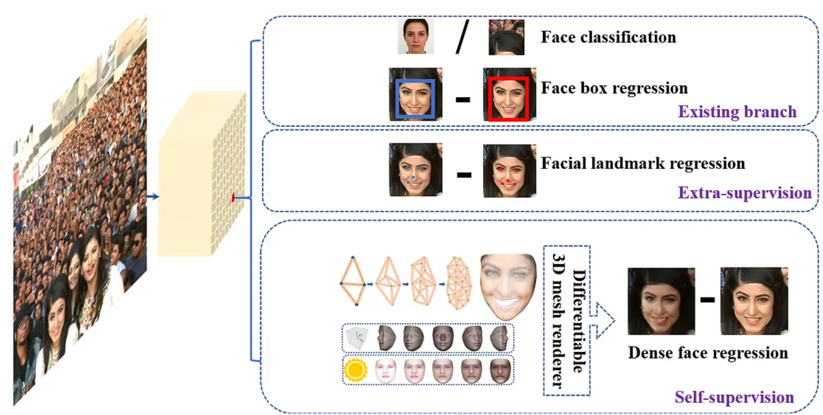
RETINA FACE
RetinaFace employs a feature pyramid network (FPN) to handle faces at different scales.
Face classification: penalizes the model for saying that there is a face at a location, while no face exists in the image.
“Face box regression”: the distance between the bounding box coordinates of the predicted face and the coordinates of the labeled face.
Facial landmark regression: it finds the distance between the predicted five facial landmarks and the labeled ones.
Dense face regression: the model’s output features are used to recreate the face, and then the recreated face is compared with the face in the image
6

Slide 9
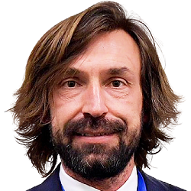
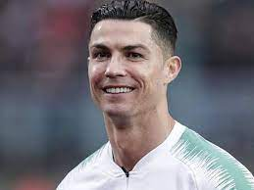
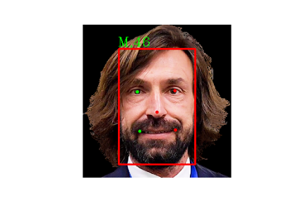
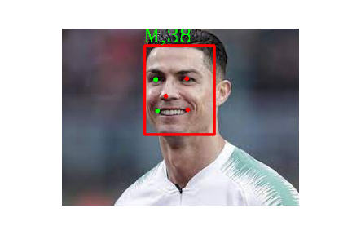
SINGLE FACE
RETINA FACE
EXAMPLES
7

Slide 10
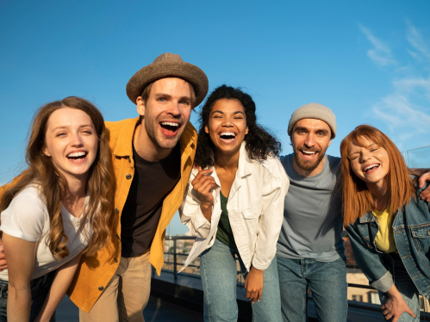
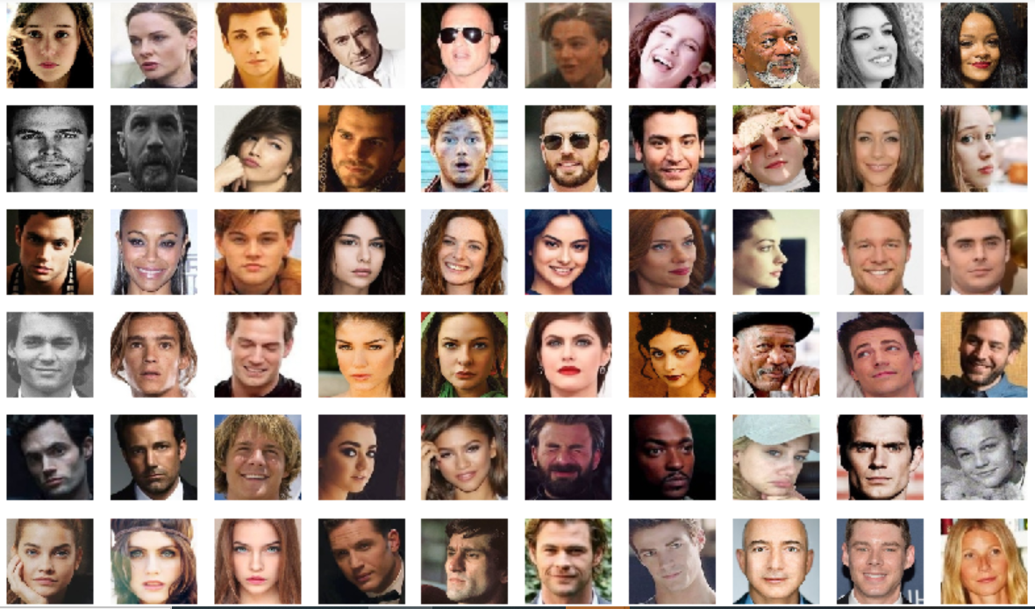
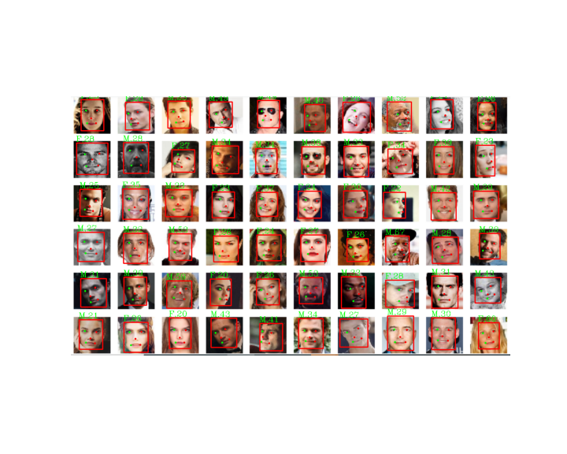
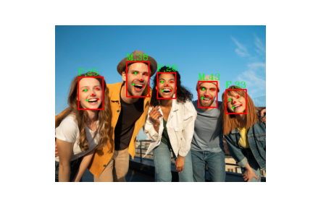
MULTIPLE FACES
RETINA FACE
EXAMPLES
8

Slide 11
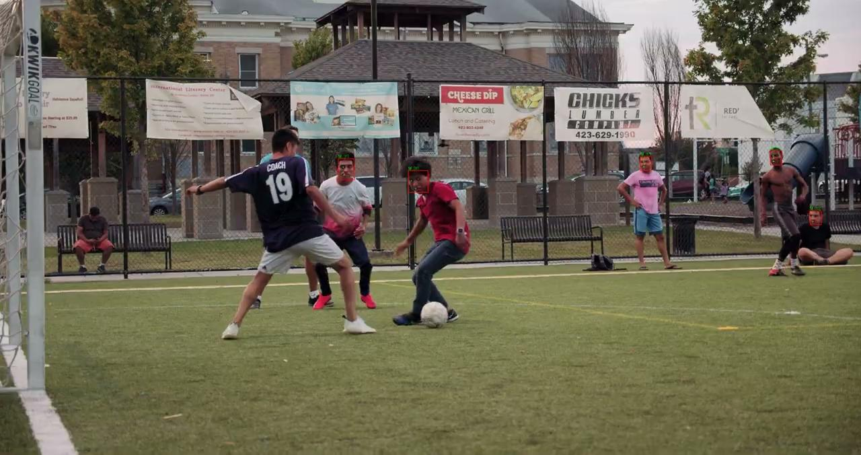
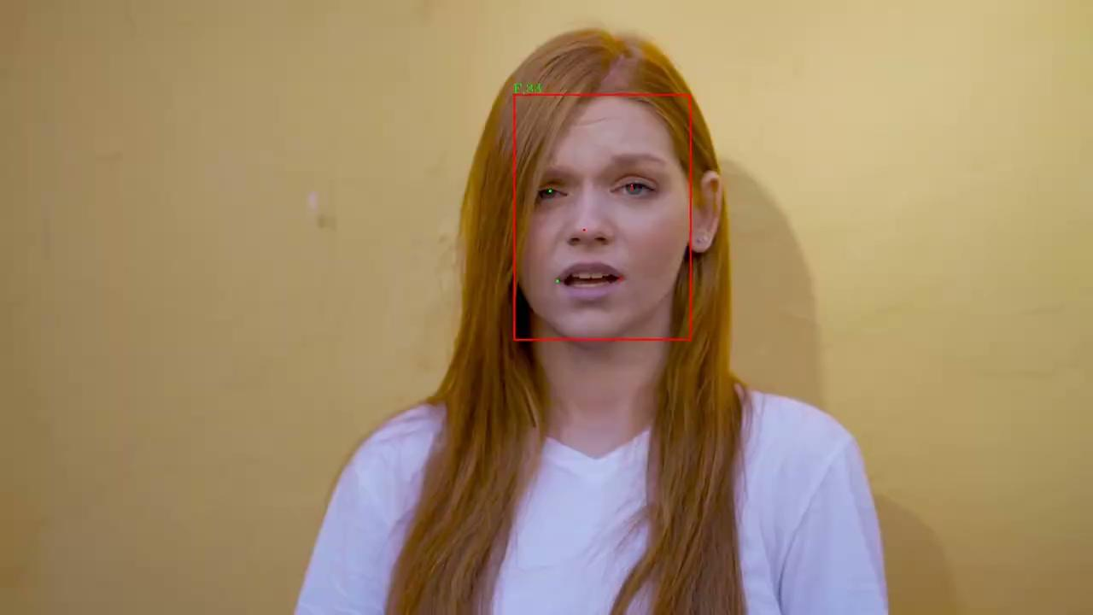
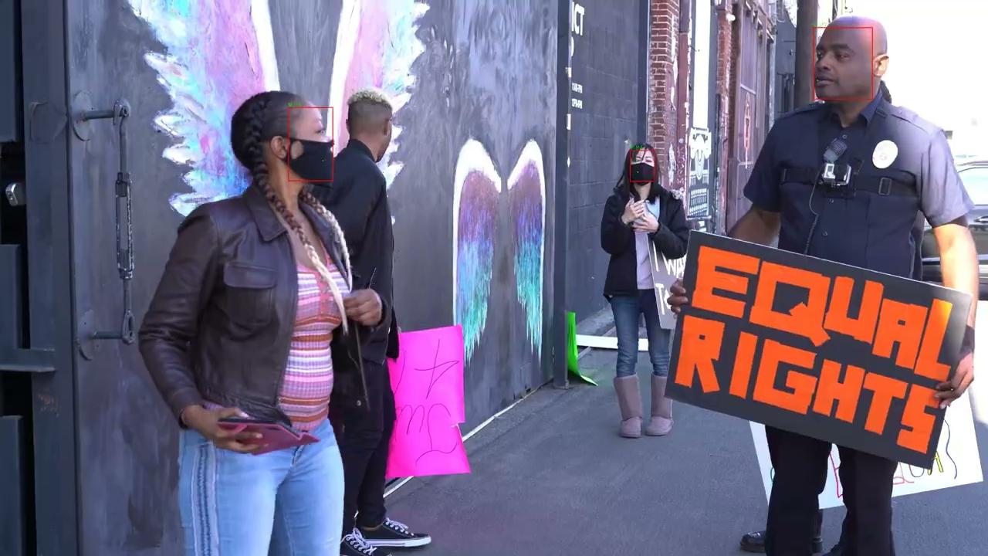
VIDEOS
RETINA FACE
EXAMPLES
9

Slide 12
ΜΑΙΝ STEPS
FACE DETECTION (based on feature pyramid network FPN)
FACE RECOGNITION (based on deep CNN)
FACE SWAPPING
10

Slide 13
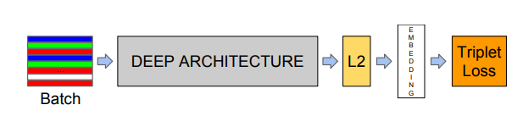
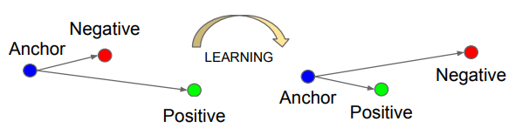
FACE
RECOGNITION
We want to ensure that an image (anchor) of a specific person is closer to all other images (positive) of the same person than it is to any image (negative) of any other person.
11

Slide 14
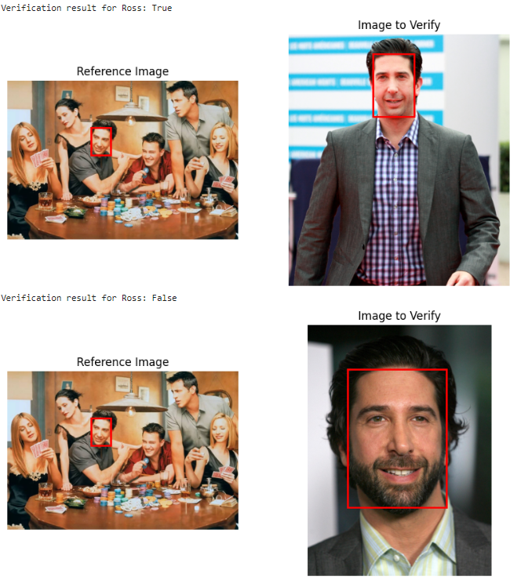
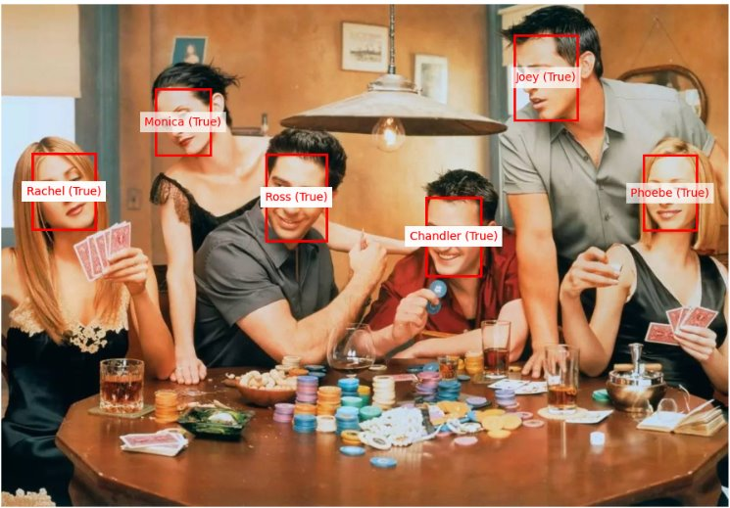
FACENET
Cosine similarity as a metric distance
Trained on dataset called the"CASIA-WebFace" ( 495k images and 11k persons)
12

Slide 15
MAIN STEPS
FACE DETECTION
FACE RECONGITION
FACE SWAPPING
13

Slide 16
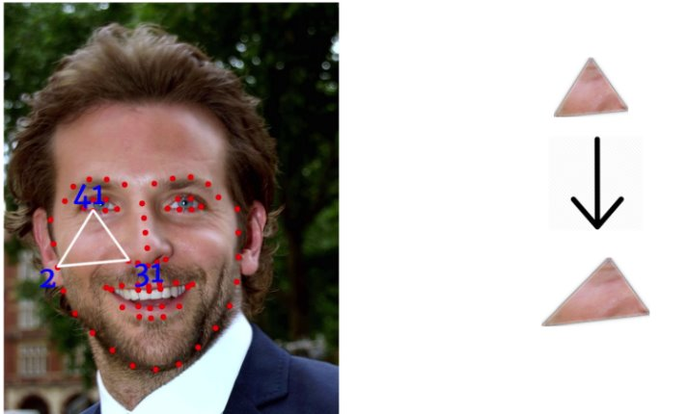
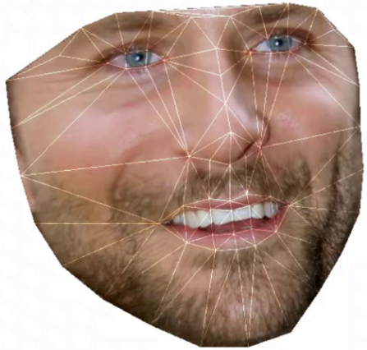
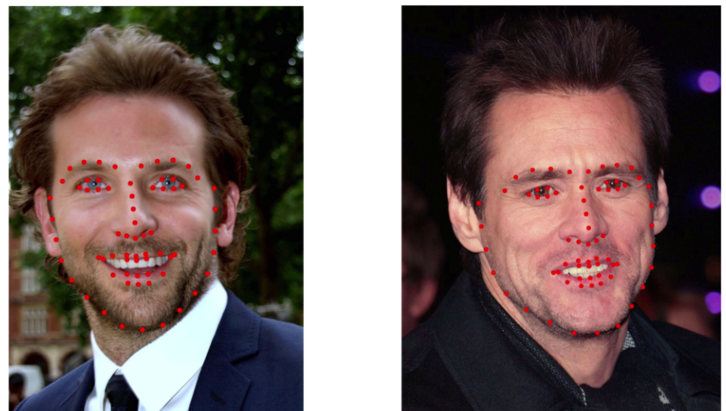
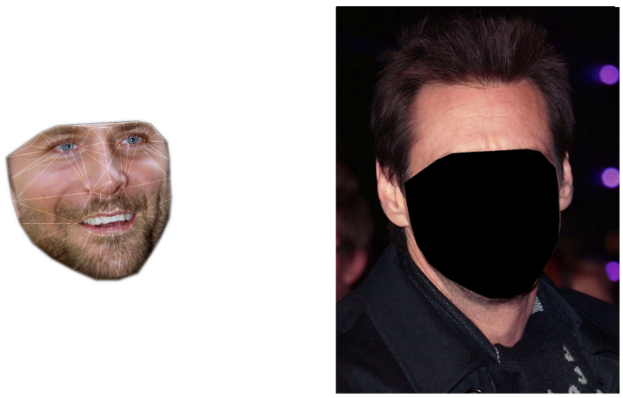
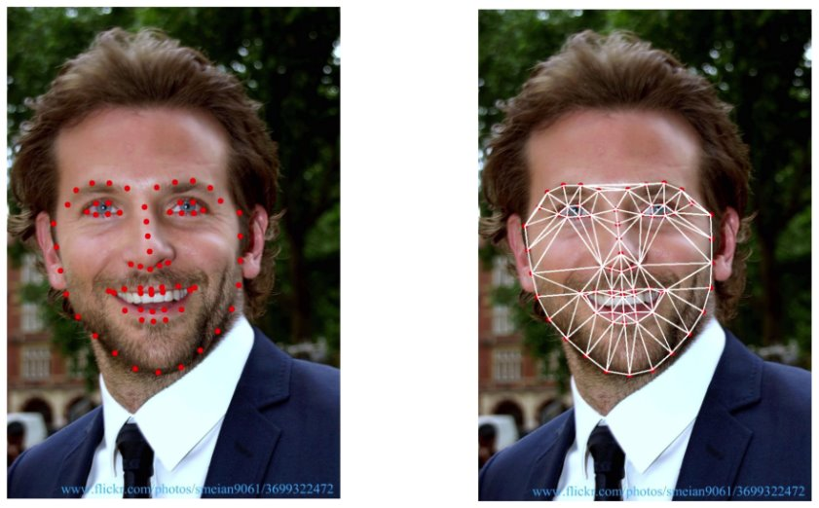
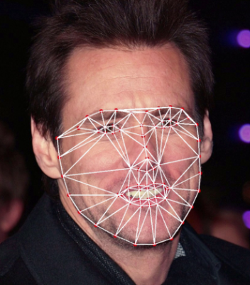
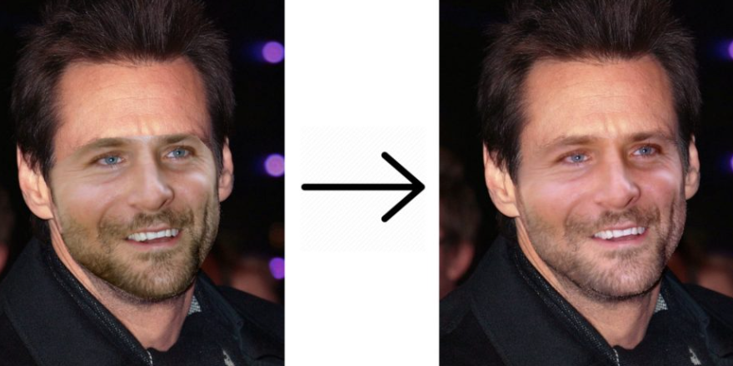
FACE
SWAPPING
4) Extract, Warp and Link the Triangles
1) Take Two Images and find Landmark Points
5) Replace The Face On The Destination (target) Image
2)Triangulation Source and destination (target) images
6) Seamless Cloning
14

Slide 17
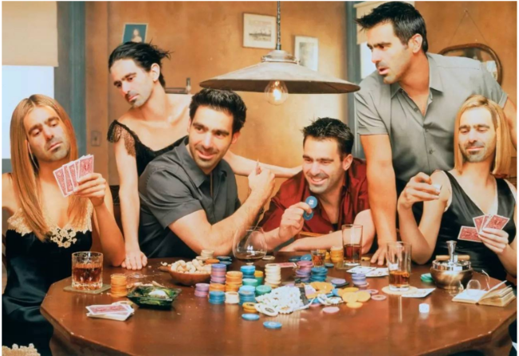
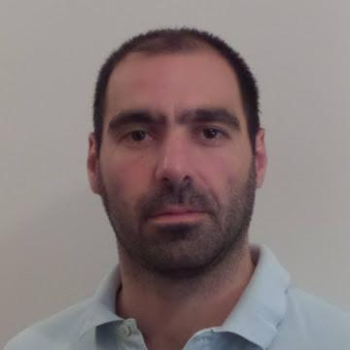
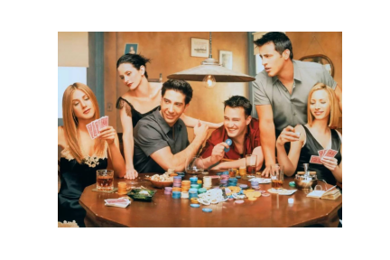
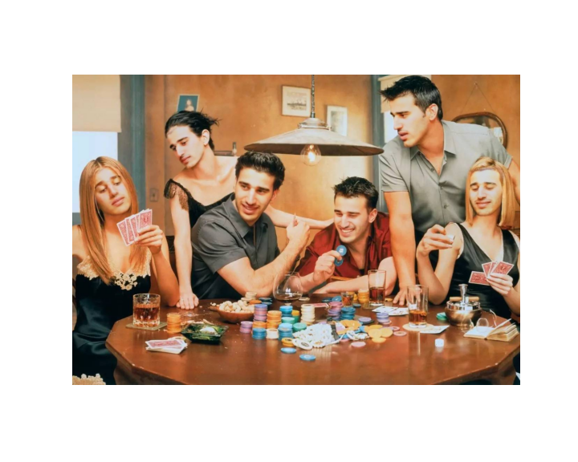

FACE
SWAPPING
EXAMPLES
TARGET IMAGE
OUTPUT IMAGE
SOURCE IMAGE
15

Slide 18
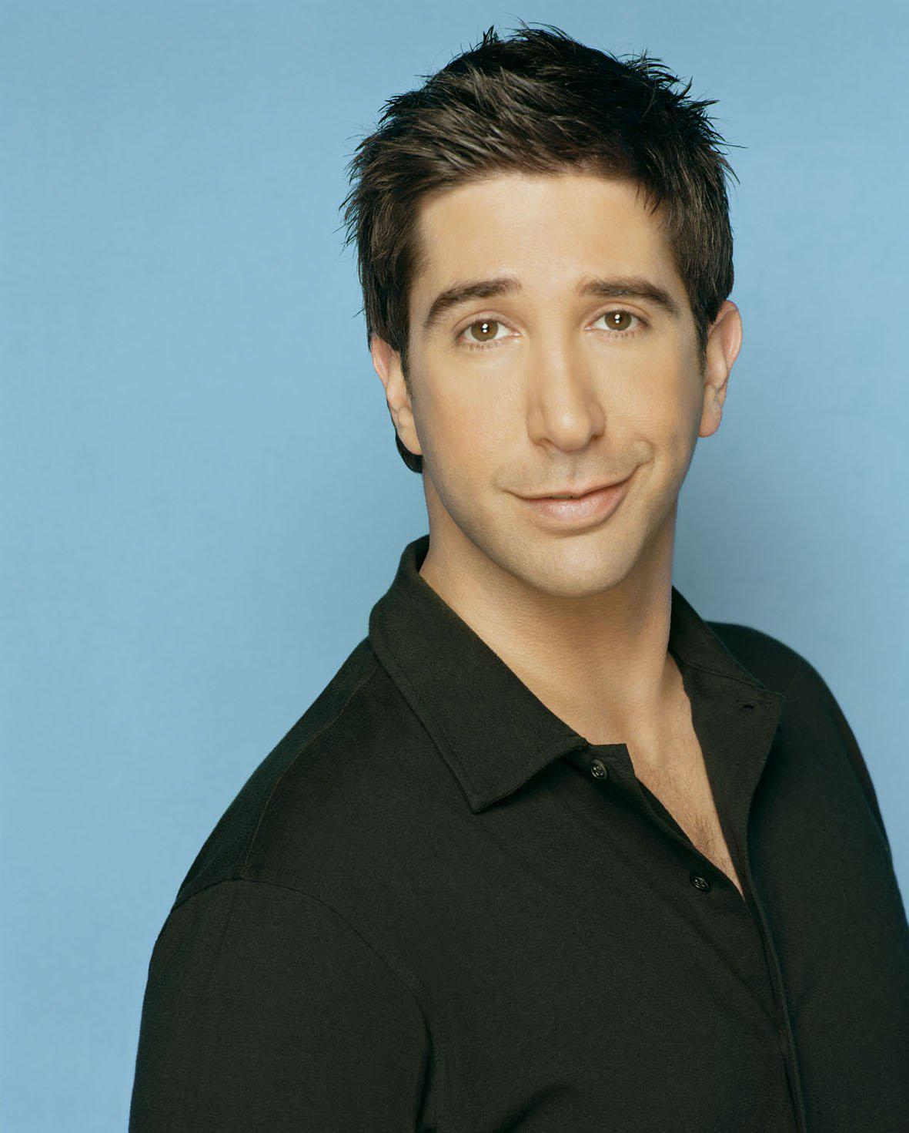
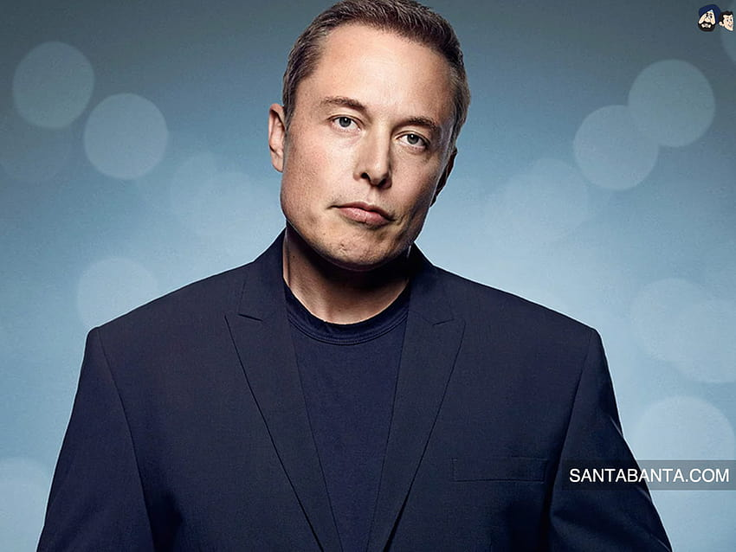
DEEPFAKE VIDEO
The face-swapping video was generated, featuring the face of Ross (F.R.I.E.N.D.S) swapped with that of Elon Musk
The input video has a duration of 90 seconds long and every third frame is utilized in the output video
To recognize the face of Ross, ten face-photos were used, capturing various expressions and lightning conditions
SOURCE FACE
TARGET FACE
16

Slide 19
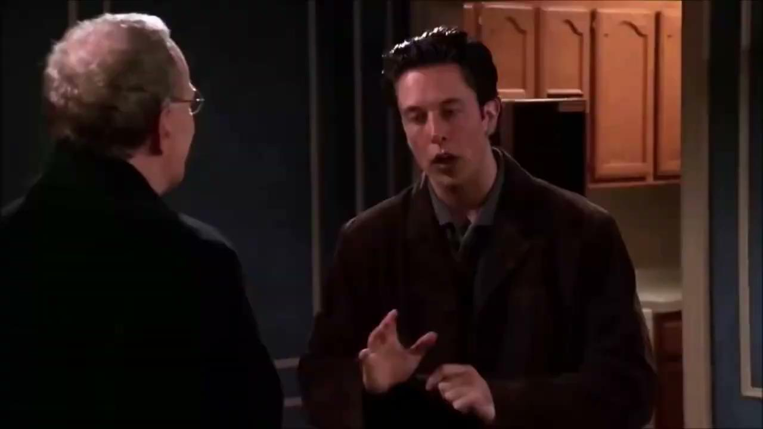
DEEPFAKE VIDEO
Source: https://www.youtube.com/watch?v=93N7PRkXmac
17

Slide 20
REFERENCES
RetinaFace: Single-stage Dense Face Localisation in the Wild https://arxiv.org/pdf/1905.00641.pdf
FaceNet: A Unified Embedding for Face Recognition and Clustering https://arxiv.org/pdf/1503.03832.pdf
ONNX Face Swapper: https://github.com/onnx/onnx
18

Slide 21
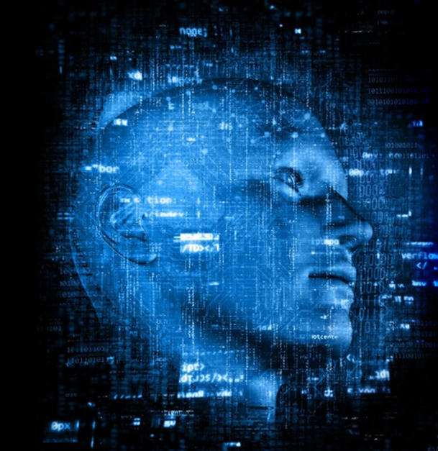
THANKS A LOT
aid24005@uom.edu.gr
aid24011@uom.edu.gr

